Slide 1


Essentials for Data Analysis
SIT112 | Intro to Data Science & AI
Lecture Week 2
Dr. Fatima Ansarizadeh
Lecturer in Applied AI
School of Information Technology, Deakin University
Email: f.ansarizadeh@deakin.edu.au
Notes:
A typical data science workflow looks like this:
Collect data from databases, sensors, APIs, or files.
Clean and prepare the data by handling missing values, duplicates, and inconsistencies.
Analyze the data (Data Analytics) to:
Understand the dataset.
Identify patterns and trends.
Detect outliers and anomalies.
Explore relationships between variables.
Build predictive or machine learning models using the insights gained from the analysis.
Evaluate and improve the models.
Deploy the model so it can make predictions or automate decisions.
Data Science
│
├── Data Collection
├── Data Cleaning
├── Data Analytics ← Essential step
├── Feature Engineering
├── Machine Learning
├── Model Evaluation
└── Deployment

Slide 2
Agenda
Create a DataFrame by reading data from a file or by using the DataFrame constructor
Save a DataFrame to disk as a pickle file, and restore the DataFrame by reading the pickle file
Examine the data in a DataFrame
Access columns, rows, or a subset of columns and rows
Use Pandas methods and attributes
Perform calculations on the data in the columns of a DataFrame.

Slide 3

Introduction to the Pandas DataFrame

Slide 4
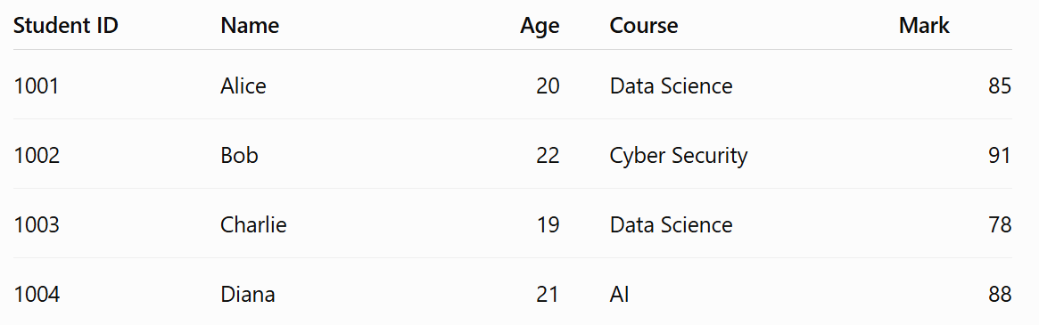
What is a DataFrame?
A DataFrame in Python is a two-dimensional data structure in the pandas library that stores data in a table-like format, similar to an Excel spreadsheet.
Rows → individual records or observations
Columns → variables or features describing the data

Slide 5
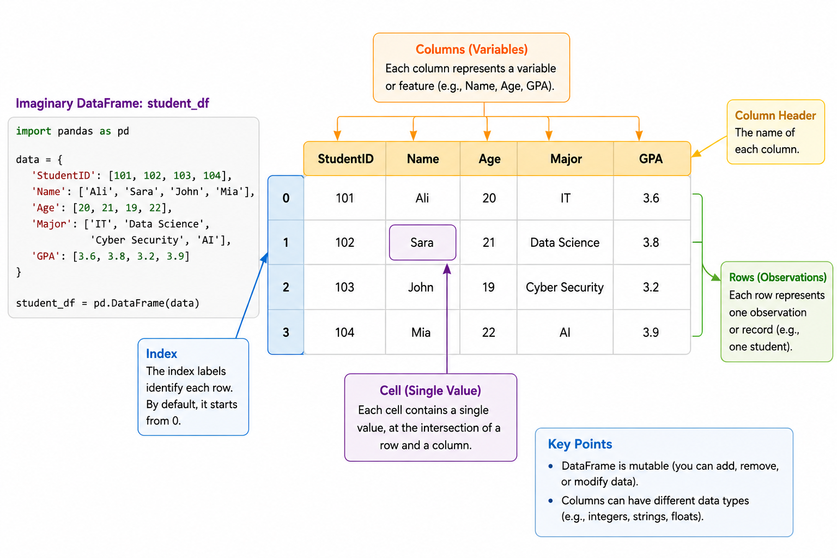
DataFrame in Python

Slide 6
Reading Data into a DataFrame
Various types of data from external sources can be read into a DataFrame.
Commonly used functions (methods) to read data into a DataFrame:
read_csv(): Read data from a CSV file.
read_excel(): Read data from an Excel file.
read_sql(): Read data from a SQL query or database table.
read_json(): Read data from a JSON file.
read_html(): Read data from an HTML file or web page into a list of DataFrame objects.
read_pickle(): Read a pickled object (serialised object) from a file.
Notes:
Go to Jupyter lab

Slide 7
DataFrame Constructor
Creates a new DataFrame object
The parameters of the DataFrame() constructor
columns: to specify the column labels for the DataFrame. It can be a list or an array. Default is integers starting from 0.
index: to specify the row labels for the DataFrame. It can be a list or an array. Default is integers starting from 0.
data: specifies the data to be used to create the DataFrame. It can be a List, a dictionary, another DataFrame, or a NumPy array.

Slide 8
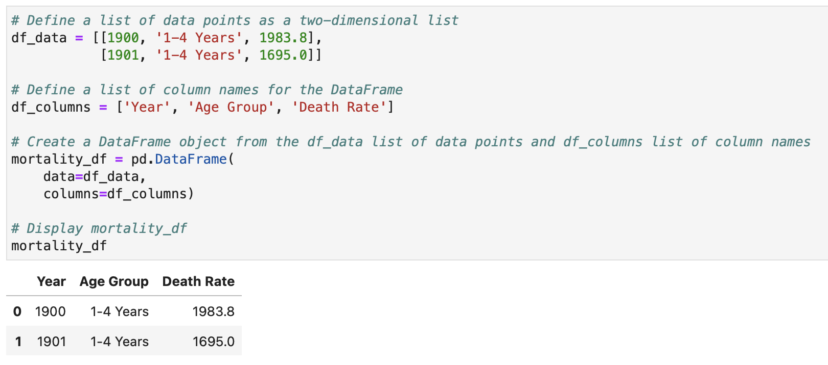
DataFrame(data, columns, index)

Slide 9
Saving a DataFrame
You can save a DataFrame to a file in a variety of formats using the to_ methods.
The following are some commonly used to_ methods to save a DataFrame:
to_csv(): Save DataFrame to a comma-separated values (csv) file.
to_excel(): Save DataFrame to an Excel file.
to_pickle(): Save DataFrame to a pickle file.
to_json(): Save DataFrame to a JSON file.
to_html(): Save DataFrame to an HTML file.
to_sql(): Save DataFrame to a SQL database.

Slide 10
Pickle Files
Pickling is the process of converting a Python object into a binary file, and unpickling is the inverse operation of loading the byte stream back into the Python object.
The pickle module is used for various purposes, such as:
Saving and loading machine learning models
Saving and loading large data structures
Notes:
1. What is a binary file?
A binary file stores data in a format that computers can read directly, using 0s and 1s.
Unlike a text file (.txt), you cannot open a pickle file and read its contents because it is not written in human-readable text.
For example:
Text file (notes.txt) → You can open it in Notepad and read the text.
Pickle file (students.pkl) → If you open it in Notepad, you'll see random symbols and unreadable characters because it is stored in binary format.
2. What does "serialized" mean?
Serialization is the process of converting a Python object (such as a list, dictionary, DataFrame, or machine learning model) into a sequence of bytes so it can be saved to a file.
Serialized object → A Python object that has been converted into bytes so it can be saved or transferred.
3. What is inside a pickle file?
A pickle file contains everything needed to reconstruct the original Python object.
Saving and loading machine learning models
Saving and loading large data structures
Caching intermediate results to disk
Pickling can save you from repeating preprocessing

Slide 11


Why pickle?
Once you create a DataFrame, it exists only while your Python program is running. If you close JupyterLab, it disappears from memory.
Instead of recreating it every time, you can pickle it:
Later, when you need it again, you unpickle it:
The DataFrame is restored exactly as it was before, with all its data and structure.
Notes:
Pickling is like saving the document to your computer. Unpickling is like opening the saved document later to continue your work.
Why do we use pickling?
We use pickling to:
Save Python objects so they can be used later.
Avoid recreating or recalculating data every time we run a program.
Save trained machine learning models so they can be reused without training them again.
In summary:
Pickling = Saving a Python object to a file.
Unpickling = Loading the saved object back into Python.

Slide 12
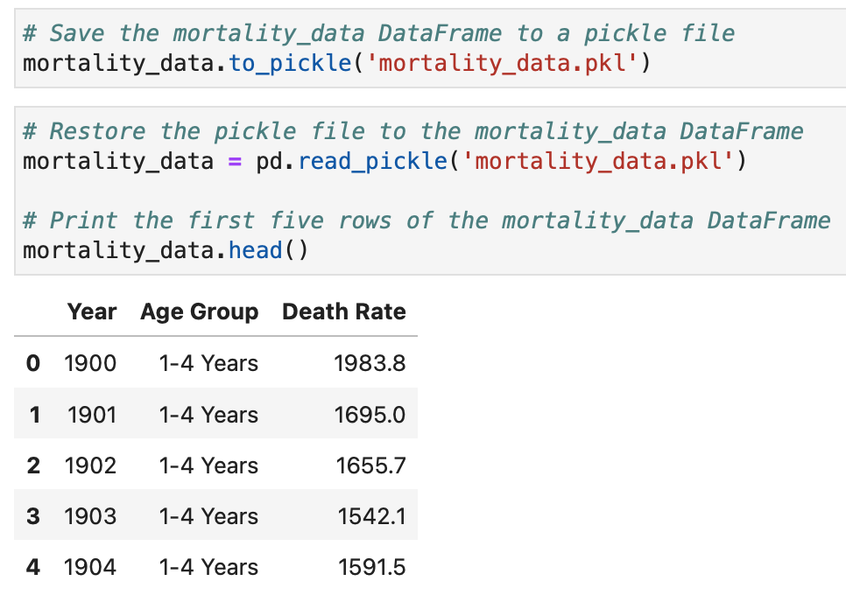
Saving a DataFrame into a Pickle File

Slide 13
How to Examine the Data

Slide 14
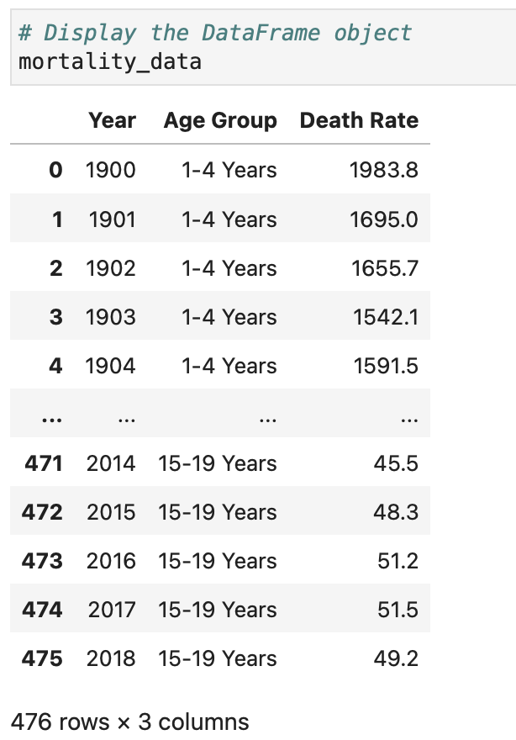
Display a DataFrame

Slide 15
Attributes of a DataFrame (Information about an object)
Attributes of a DataFrame object are properties that describe the DataFrame. Unlike methods, attributes provide information about the DataFrame and do not require parentheses.
Attribute | What it tells you
df.shape | Number of rows and columns
df.columns | Column names
df.index | Row labels
df.dtypes | Data type of each column
df.size | Total number of values
df.ndim | Number of dimensions
df.values | The data as a NumPy array
Notes:
Df.ndim: A DataFrame is always two-dimensional because it has rows and columns.
Df.size: Returns the total number of values in the DataFrame.
Df.values => numbers and strings…everything is dataset

Slide 16
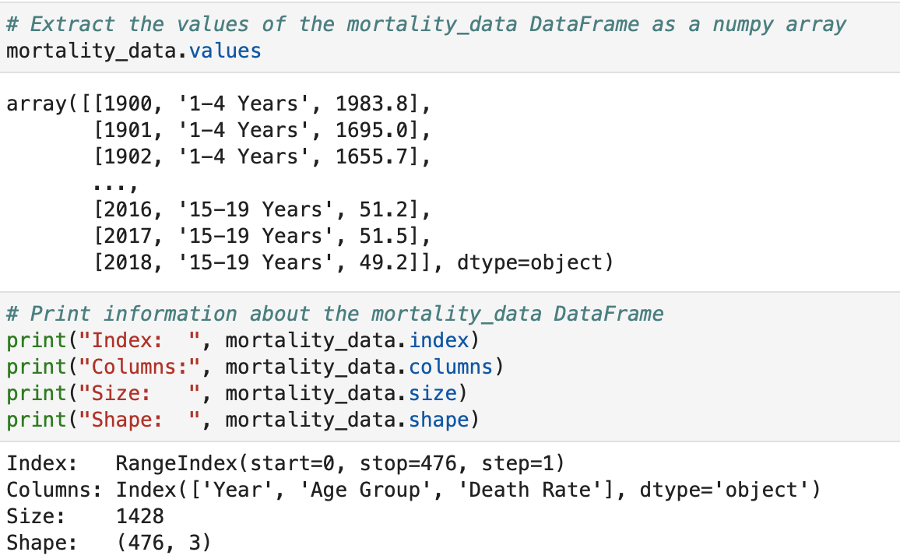
Display the Attributes of a DataFrame

Slide 17
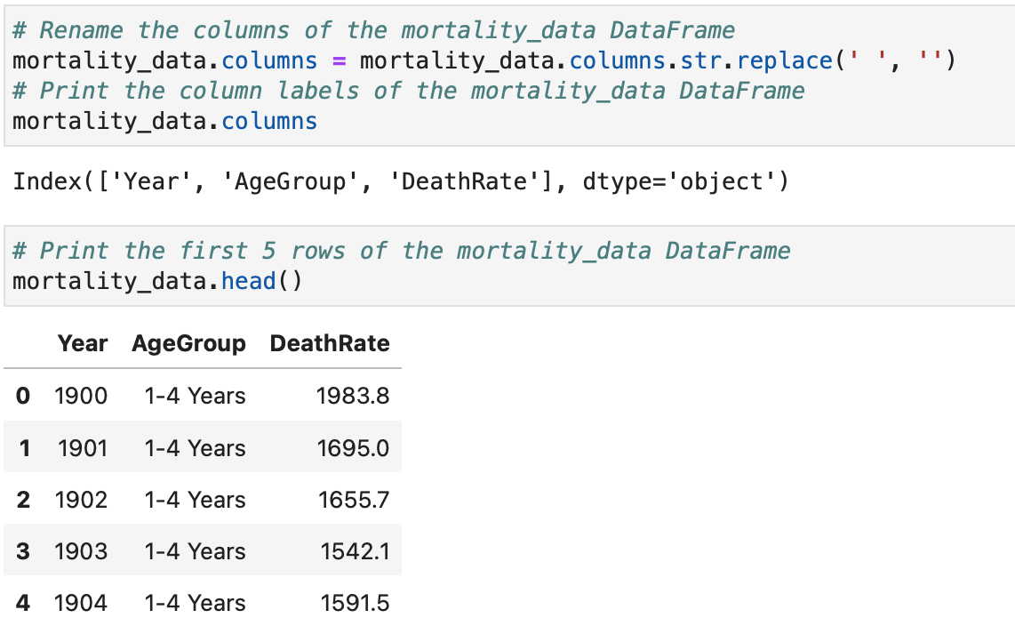
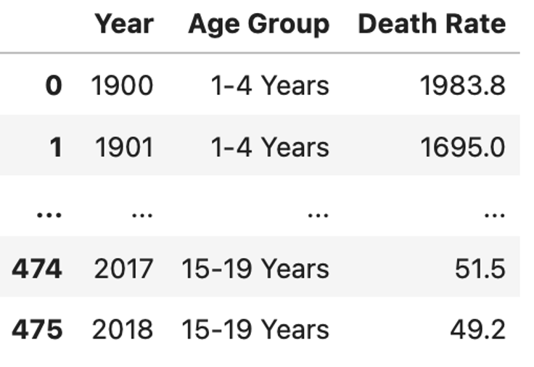
Use the Columns Attribute to Replace Spaces with Nothing

Slide 18

Methods of a DataFrame (Action performed by an object)
It is a function that belongs to a DataFrame object and allows you to perform operations on the data.
Method | Purpose
df.head() | View first rows
df.tail() | View last rows
df.info() | Data structure summary
df.describe() | Statistical summary
df.drop() | Remove rows/columns
df.rename() | Rename columns
df.sort_values() | Sort data

Slide 19
Methods vs. Attributes
Attributes | Methods
Describe the DataFrame | Perform an action on the DataFrame
No parentheses () | Use parentheses ()
Example: df.shape | Example: df.head()
Notes:
Exploratory Data Analysis (EDA) to quickly understand the data distribution.

Slide 20
info(), nunique(), and describe() Methods
Method | Description
.info(params) | Returns information about the DataFrame and its columns.
.nunique() | Returns the number of unique data items in each column.
.describe() | Returns statistical information for each numeric column.

Slide 21
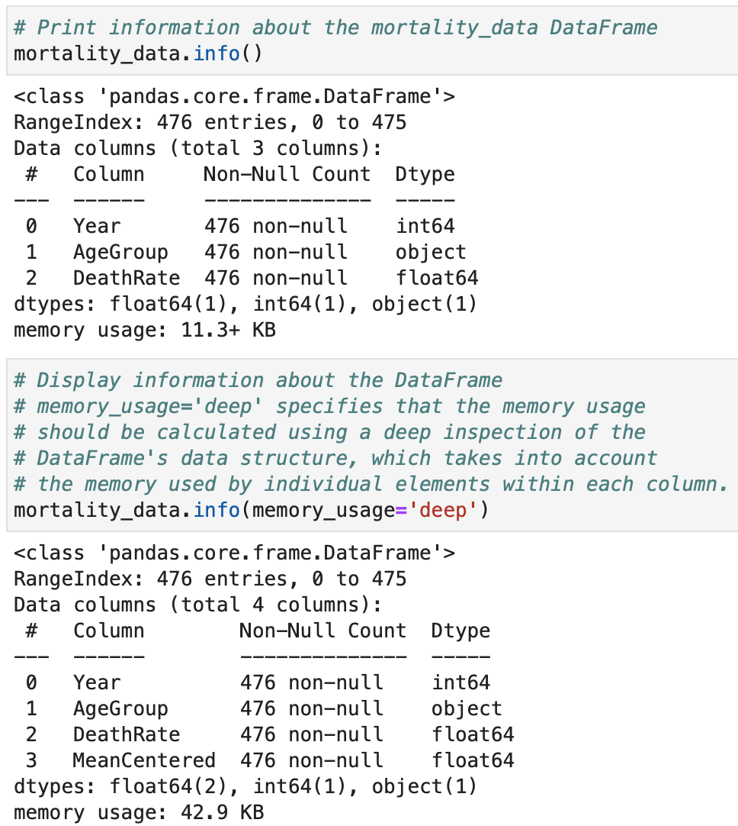
Using the info() Method

Slide 22
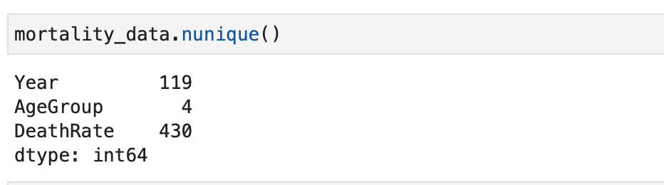
Using the nunique() Method

Slide 23
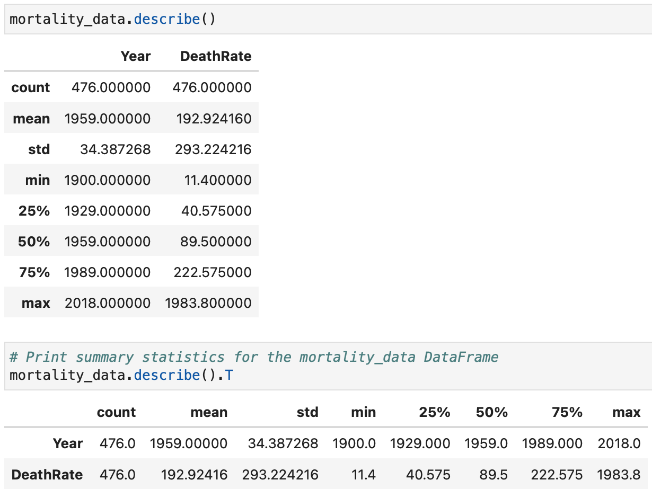
Using the describe() Method

Slide 24
How to Access the Columns and Rows

Slide 25
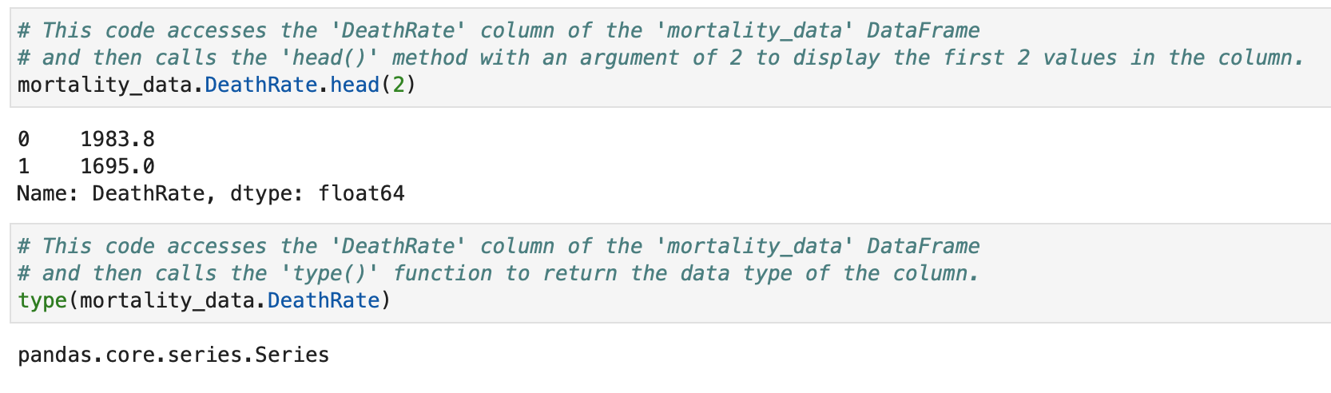
Accessing Columns with Dot Notation

Slide 26
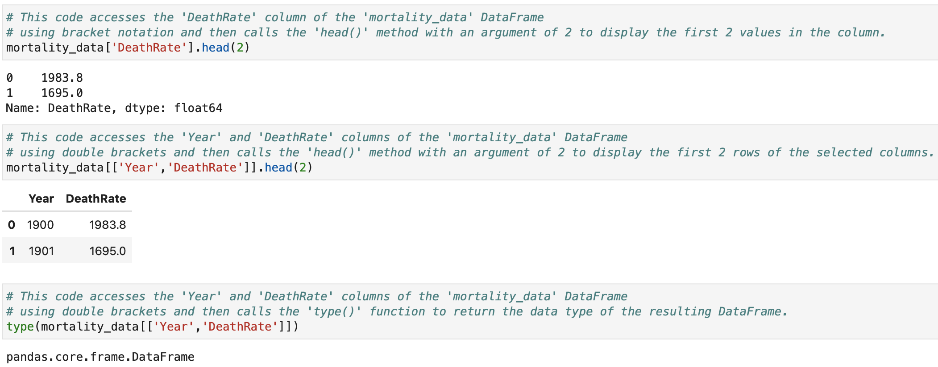
Accessing Columns with Brackets

Slide 27

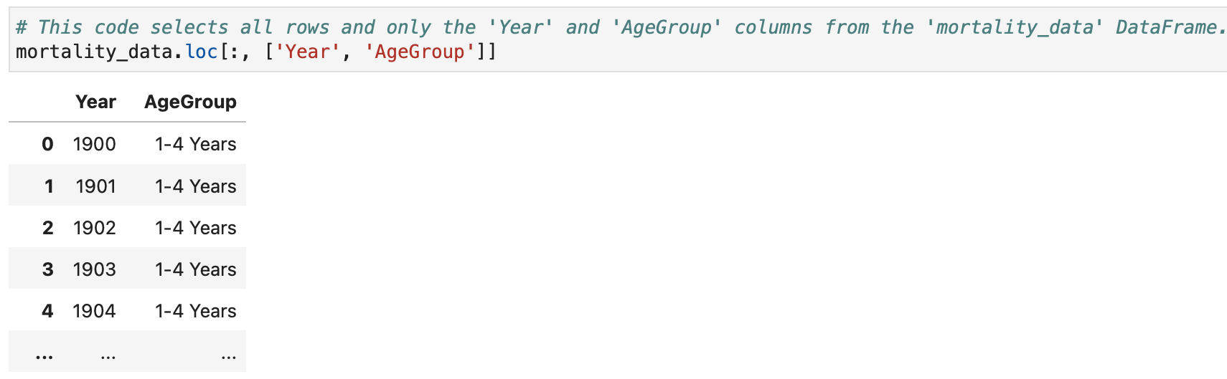
Accessing Columns using loc[ ]
Notes:
df.loc[] is a Pandas indexer used to select or modify rows and columns by their labels (names).
loc[] uses row and column labels, not their numerical positions.

Slide 28

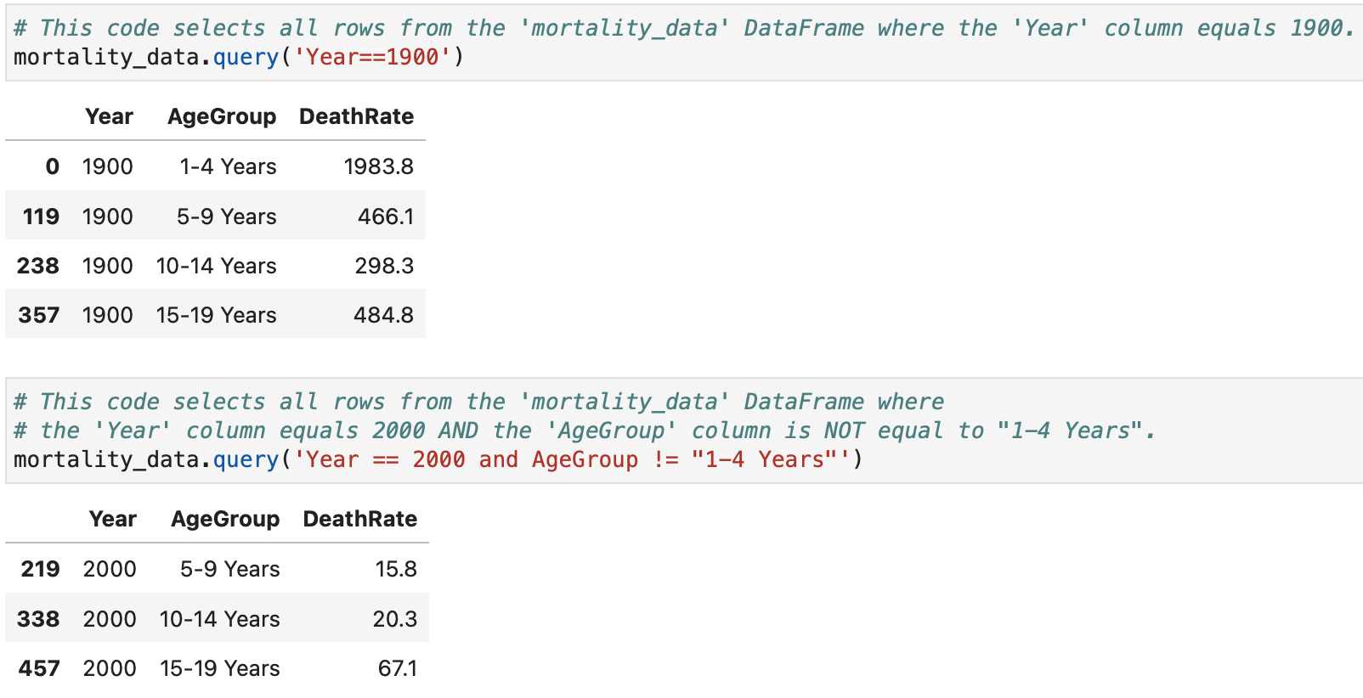
Accessing Rows using query() based on One Column
Notes:
The Pandas query() method is used to select rows from a DataFrame based on a condition. It provides a simple way to filter data using column names directly. The condition is written as a string and uses column names to define which rows should be selected.
df[df["Age"] > 20] same as df.query("Age > 20")
Why use query()?
Easier to read when conditions become complex.
Allows direct use of column names.
Makes filtering expressions look closer to natural language.
Important Notes
Column names are written without quotes.
2. String values need quotes : df.query("Name == 'Bob’”)
3. Multiple conditions
Use:
and for both conditions
or for either condition

Slide 29

Accessing Rows using query() Across Multiple Columns with AND
Notes:
Each condition is evaluated separately. A row is returned only if all conditions are True.
df.query("Age > 20 and Grade > 85") same as df[(df["Age"] > 20) & (df["Grade"] > 85)]
Important Notes
Use and, not &, inside query()
& is used with Boolean indexing, not normally inside query().

Slide 30

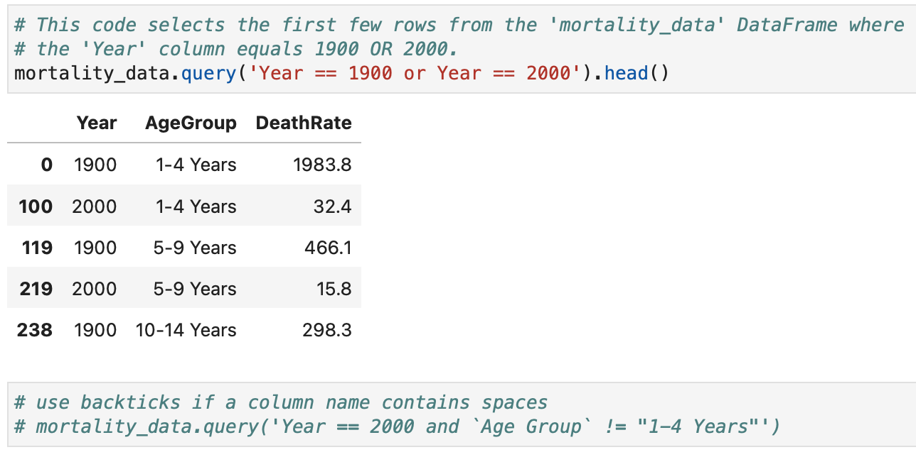
Accessing Rows using query() Across Multiple Columns with OR
Notes:
At least one of multiple conditions is true.
Each condition is evaluated separately. A row is returned if one or more conditions are True.

Slide 31
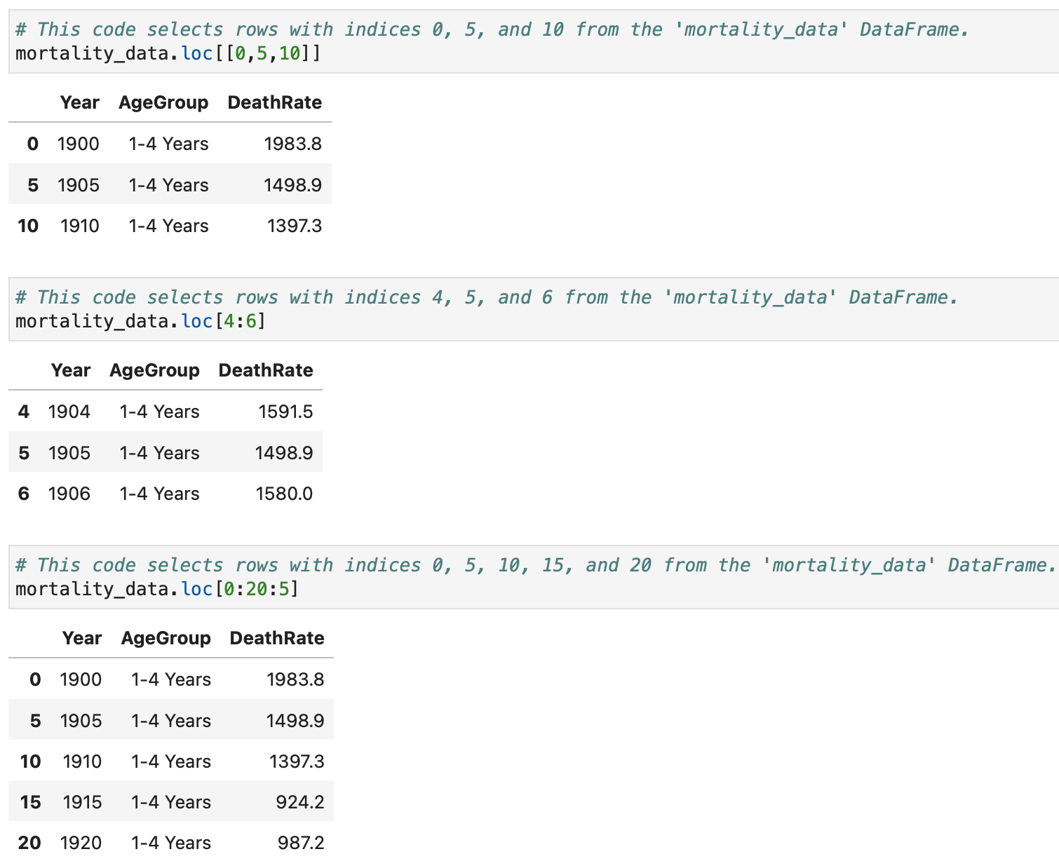

Accessing Rows using loc[]

Slide 32
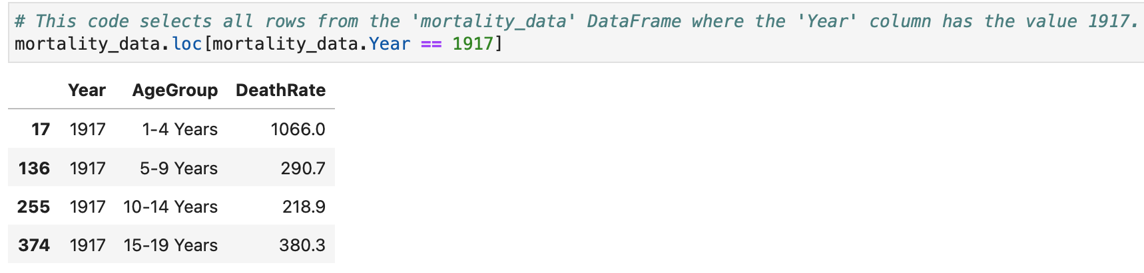
Accessing Rows using loc[] – Cont.

Slide 33
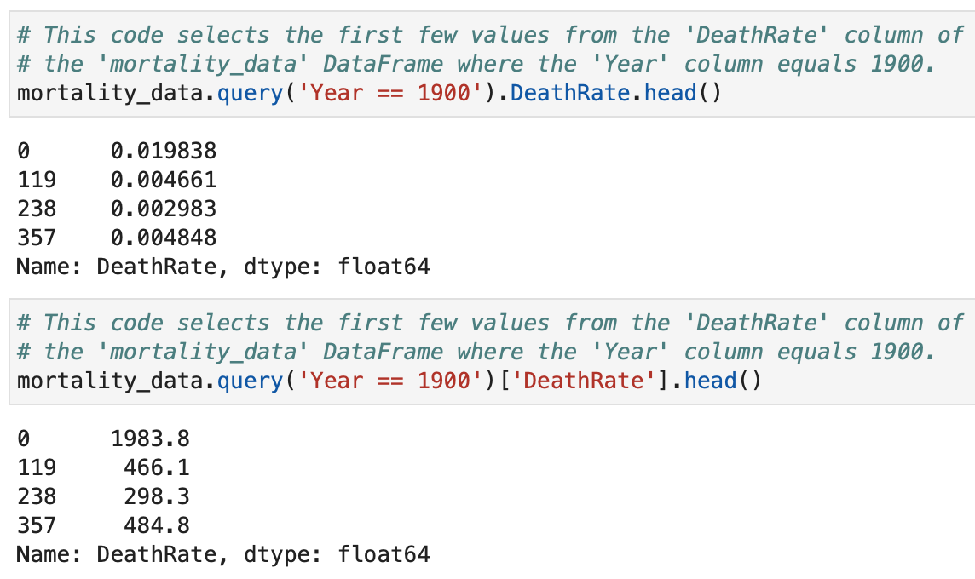


Access a Subset of Rows and Columns using query ()
Notes:
The Pandas query() method is mainly used to filter rows based on conditions. To access a subset of rows and specific columns, combine query() with the column selection operator [].
query() → selects rows that satisfy the condition.
[["column1", "column2"]] → selects the required columns from those rows.
you can select a single column using the dot notation (.column_name) instead of using [["column_name"]].
The dot notation cannot select multiple columns.
Dot Notation Limitations
You can only use .column_name when:
Column name is a valid Python identifier
For example: Does not work:
df.Student Age # contains space
df.Total-Grade # contains special character
For these cases, use:
df["Student Age"]
df["Total-Grade"]
2. Column name does not conflict with DataFrame methods
For example, if you have a column called count:
df.count
may refer to the DataFrame method count() rather than your column.
Use:
df["count"]
instead.
Dot notation: df.query("Age > 20").Grade Select one column
Bracket notation: df.query("Age > 20")["Grade"] Select one column (recommended)
Double brackets df.query("Age > 20")[["Name", "Grade"]] Select multiple columns

Slide 34
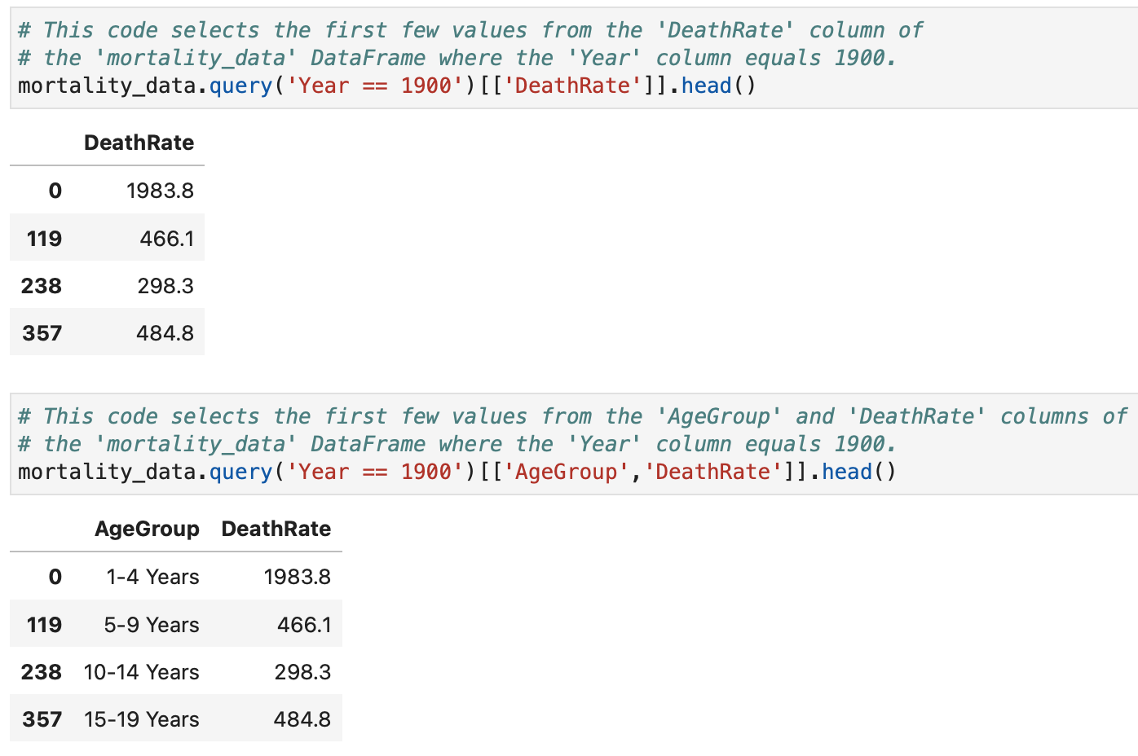

Access a Subset of Rows and Columns using query () – Cont.

Slide 35

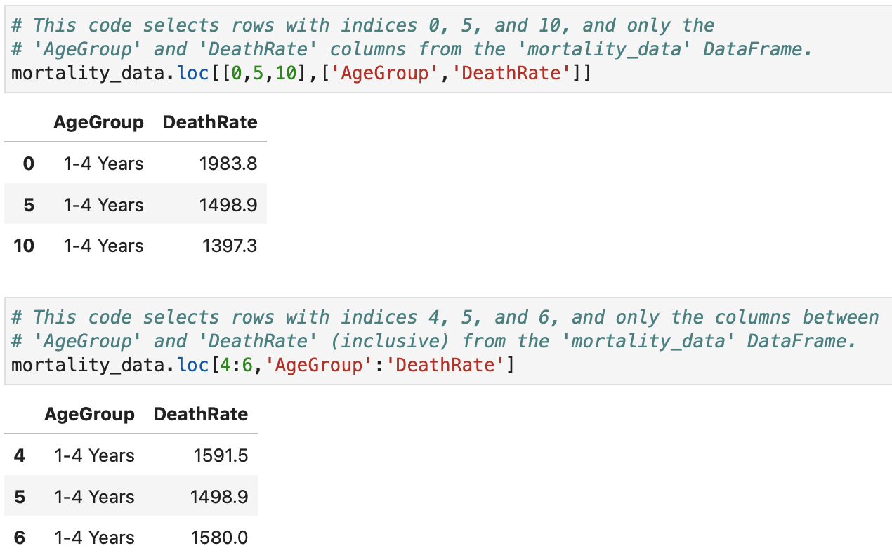
Access a Subset of Rows and Columns using loc[]

Slide 36
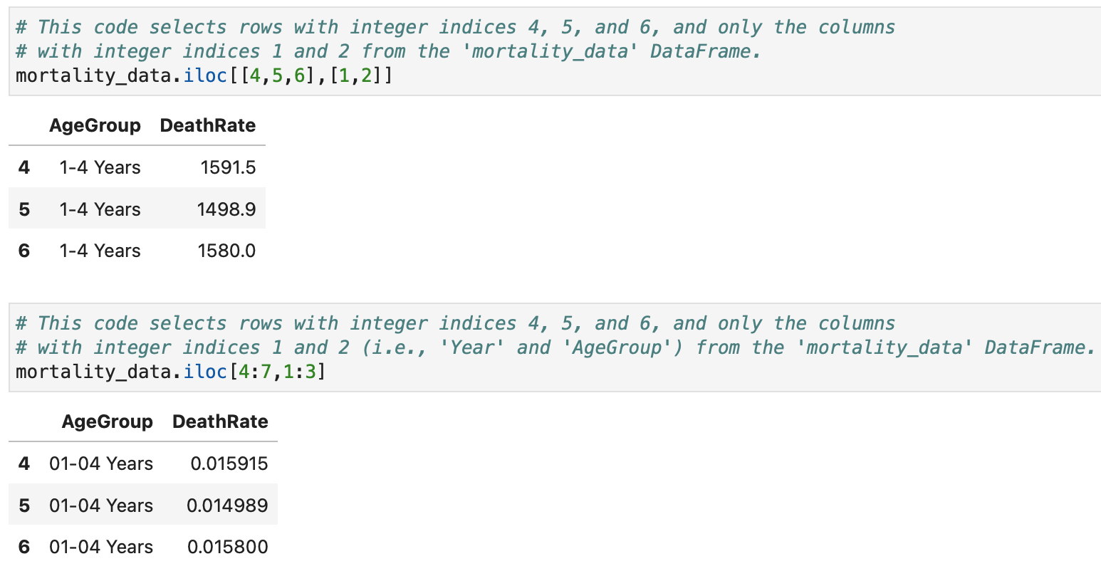
Access Rows and Columns using iloc[]
Notes:
iloc[] follows normal Python slicing rules, where the end position is excluded.
df.iloc[0:2]
Select rows at positions 0 and 1 (stop before position 2).
With loc[]: The last column (Age) is included.
Last value included?
loc[] Label-baseddf.loc[0:2]✅ Yes
iloc[] Position-baseddf.iloc[0:2]❌ No
Python list slicingPosition-basedlist[0:2]❌ No

Slide 37

What’s the difference between loc[] and iloc[] ?
Ask ChatGPT ☺

Slide 38
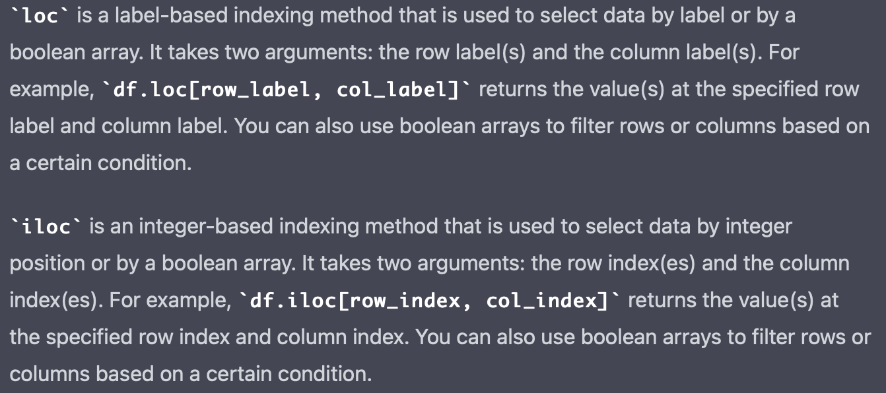
What’s the difference between loc[ ] and iloc[ ]?

Slide 39
How to Prepare the Data

Slide 40
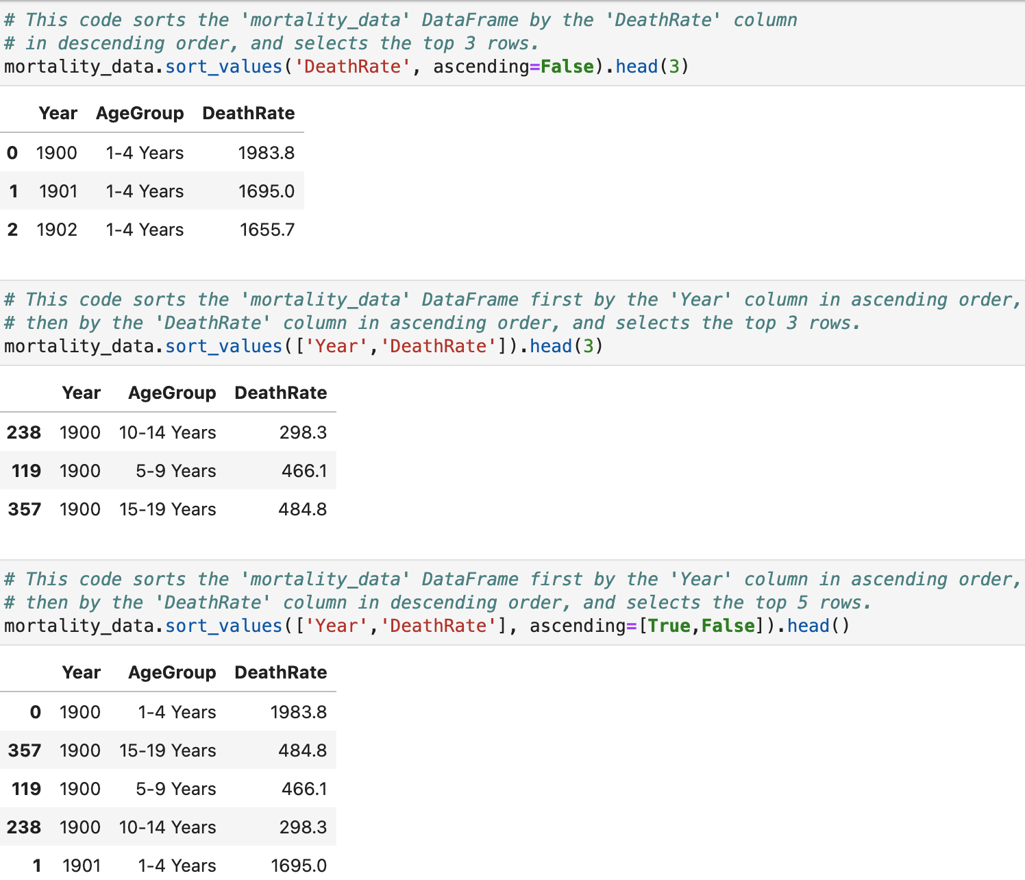

Sorting the Data
Notes:
Arrange the rows based on the values in one or more columns.
By default, sorting is performed in ascending order.
Sort by Multiple Columns.
First column is done first then second column among similar values of the first column is studied.
By default, sort_values() returns a new sorted DataFrame and does not change the original one.
To modify the original DataFrame:
df.sort_values(by="Age", inplace=True)
df.sort_index(ascending=False) This sorts rows from the largest index to the smallest.

Slide 41
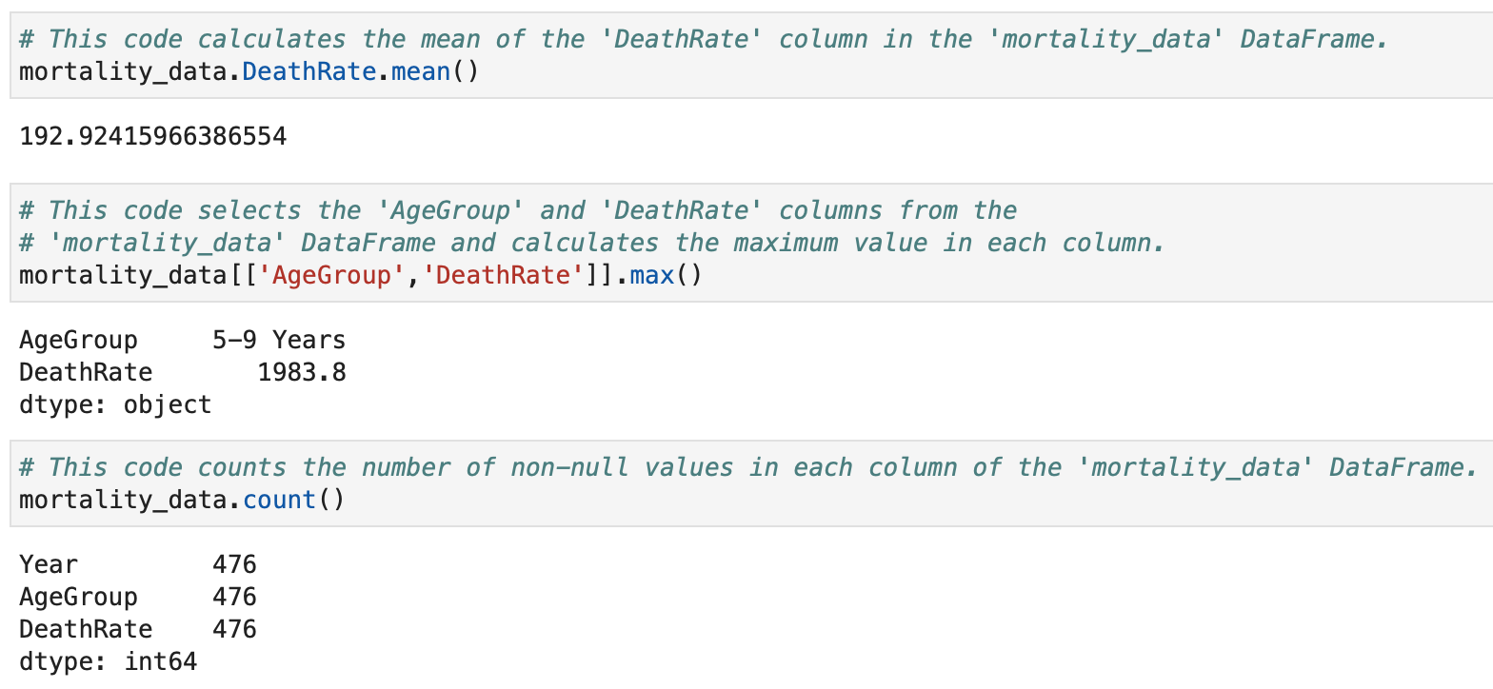
Applying Statistical Methods

Slide 42
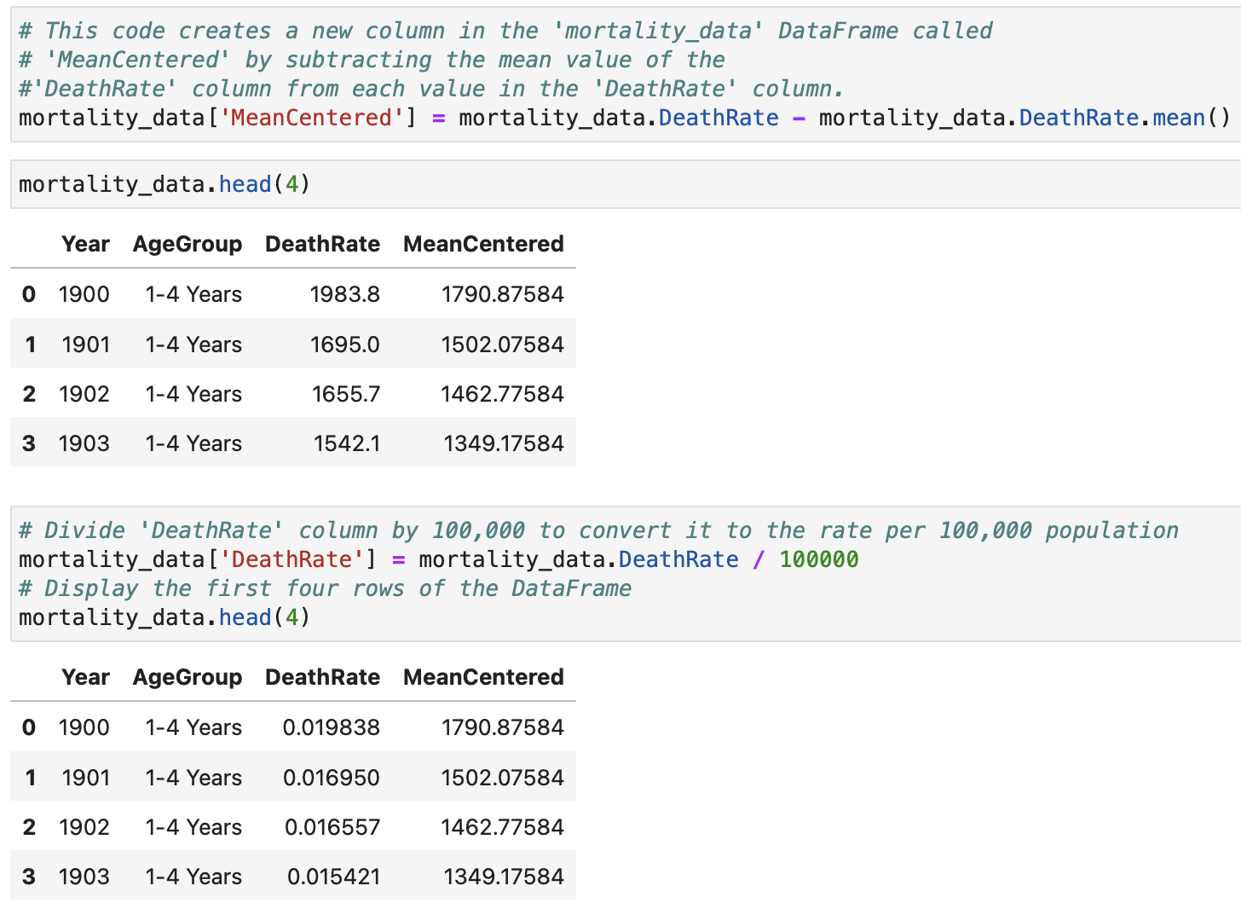
Column Arithmetic

Slide 43
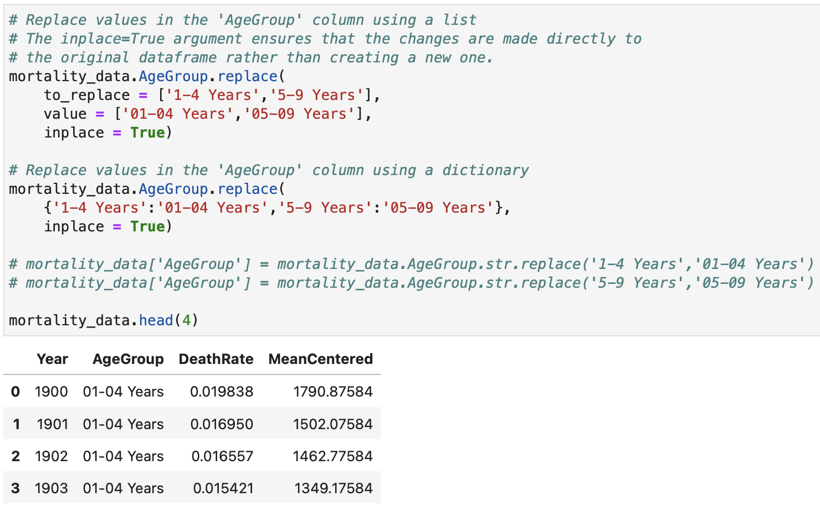
Modifying the String Data in a Column

Slide 44
How to Shape the Data

Slide 45
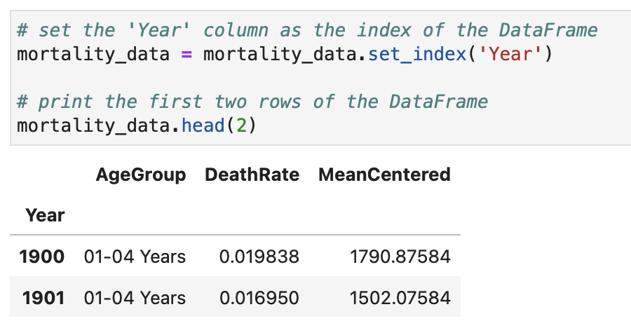
Setting and Using an Index
Notes:
set_index() is a DataFrame method used to replace the default row index with one or more existing columns from the DataFrame.
By default, Pandas creates a numerical index:
0, 1, 2, 3, ...
set_index() allows you to choose a meaningful column (such as ID, date, or name) as the row labels.

Slide 46
Pivoting the Data
Transforming rows into columns, or vice versa, in a dataset.
To restructure data to make it more useful for analysis or reporting purposes.
To pivot data, you typically identify a column of interest that you want to become the new column headers, and a second column that contains the values that should be placed under each new header.
Notes:
It is commonly used to change the layout of data so that it becomes easier to analyse, summarise, or present in reports.
When you pivot a dataset, you usually select:
Index column – the column that remains as the row labels.
Columns column – the column whose unique values become the new column headers.
Values column – the column containing the data values that fill the new table.
Pivoting is useful when you want to:
Compare categories side-by-side
Example: Compare sales of different products across months.
Create summary tables
Example: Convert transaction-level data into a reporting format.
Prepare data for visualisation
Example: Create a table suitable for plotting trends.
Make data easier to analyse
Example: Convert long-format data into wide-format data.
Long Format vs Wide Format
Before pivoting (long format):
Student
Subject
Mark
After pivoting (wide format):
Student
Math
Science

Slide 47
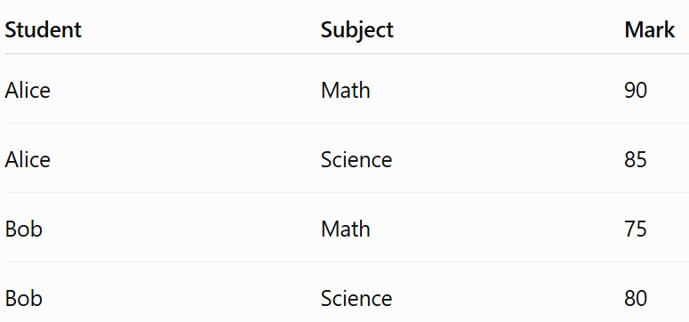
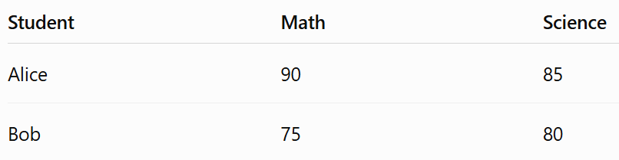
Example
Long Format vs Wide Format
Notes:
It is commonly used to change the layout of data so that it becomes easier to analyse, summarise, or present in reports.
When you pivot a dataset, you usually select:
Index column – the column that remains as the row labels.
Columns column – the column whose unique values become the new column headers.
Values column – the column containing the data values that fill the new table.
Pivoting is useful when you want to:
Compare categories side-by-side
Example: Compare sales of different products across months.
Create summary tables
Example: Convert transaction-level data into a reporting format.
Prepare data for visualisation
Example: Create a table suitable for plotting trends.
Make data easier to analyse
Example: Convert long-format data into wide-format data.
Long Format vs Wide Format
Before pivoting (long format):
Student
Subject
Mark
After pivoting (wide format):
Student
Math
Science

Slide 48
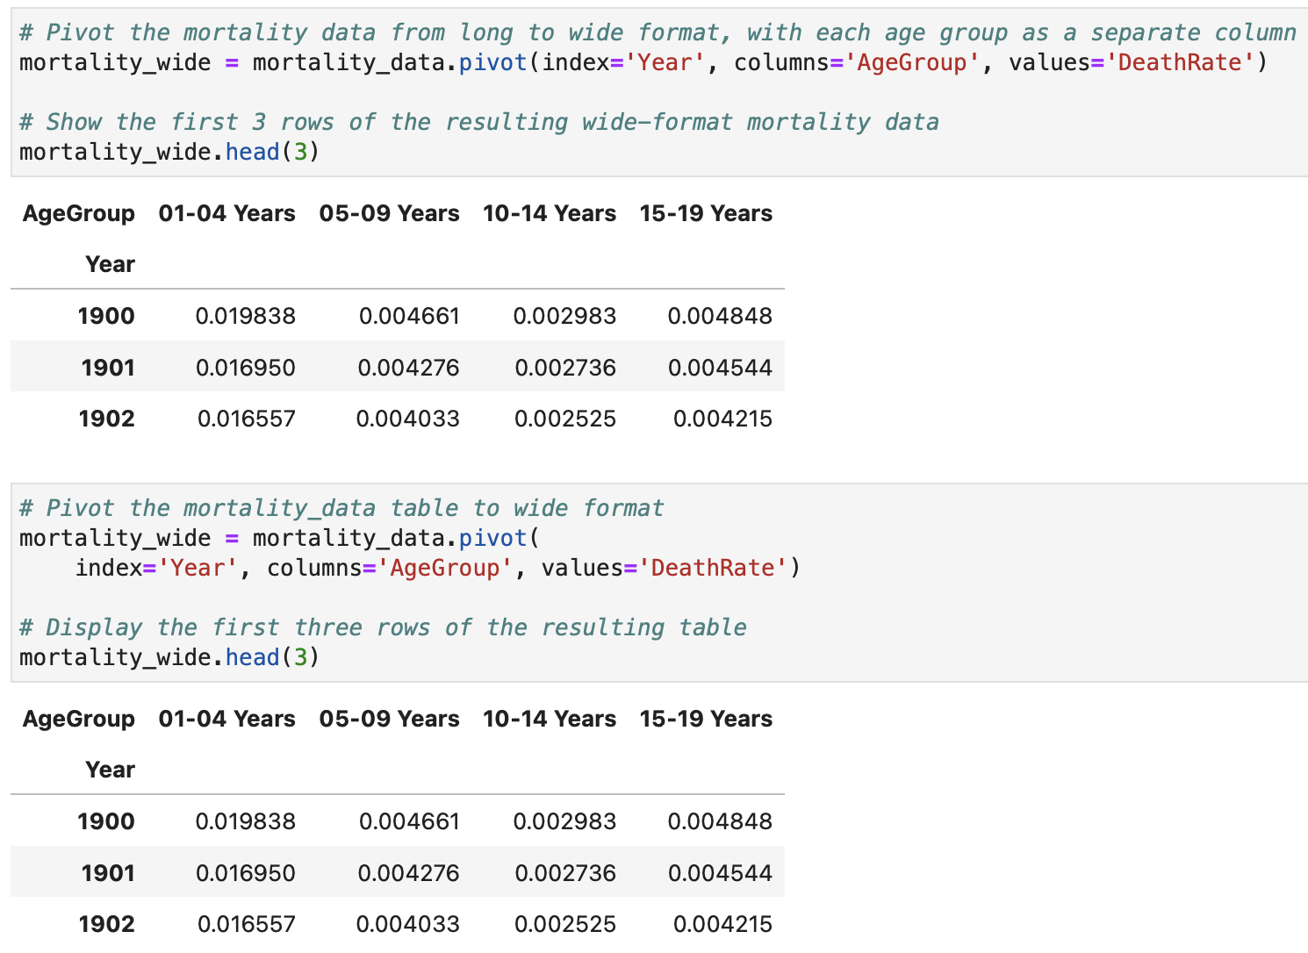
Pivoting the Data (Cont.)

Slide 49

Melting the Data
The process of transforming a dataset from a wide format to a long format.
Typically involves taking columns of data and converting them into rows.
Can be useful for data analysis and visualisation.
Pivoting: Converts rows → columns (long format → wide format)
Melting: Converts columns → rows (wide format → long format)
Notes:
Melting data is the process of transforming a dataset from a wide format into a long format. It converts multiple columns into rows, making the dataset easier to analyse, visualise, and process with many data analysis tools.
Long-format data makes operations such as:
grouping,
filtering,
aggregation,
statistical analysis
simpler.
id_vars: Columns that should remain unchanged (identifier columns)
var_name: Name of the new column containing former column names
value_name: Name of the new column containing values
Pivot = Spread data out Melt = Stack data together

Slide 50
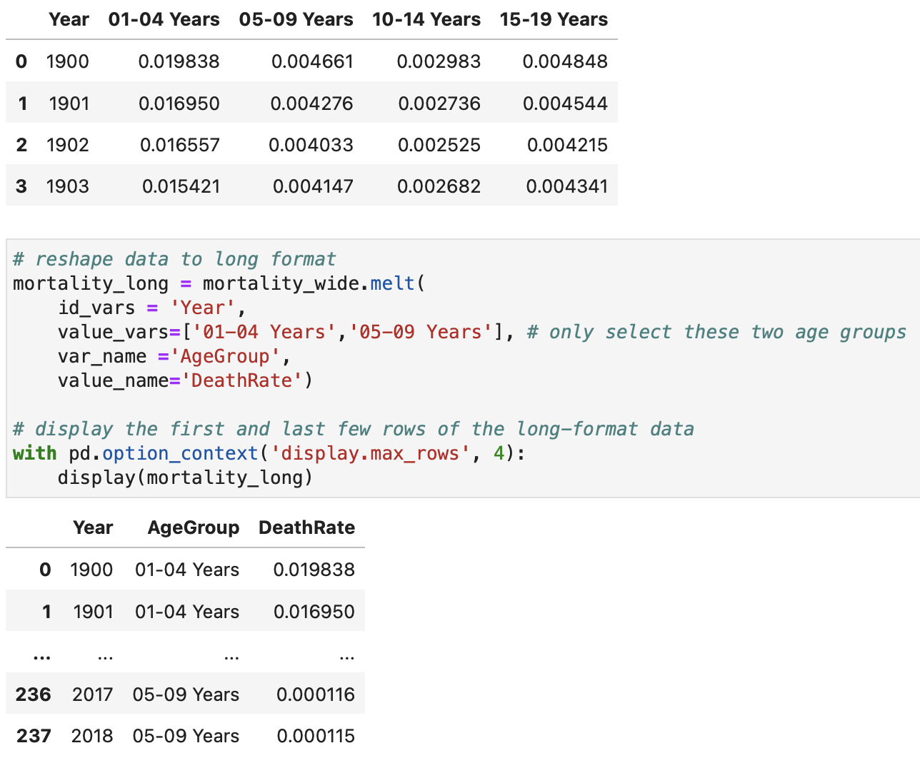
Melting the Data (Cont.)

Slide 51
Analyze the Data

Slide 52
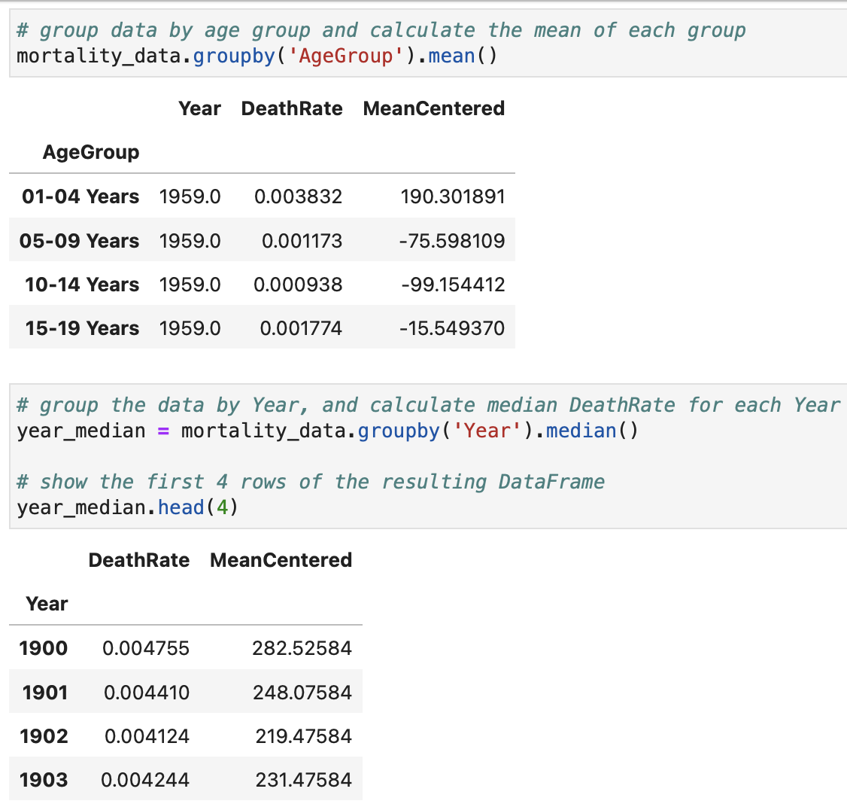
Group the Data
Notes:
split data into groups based on one or more columns, perform calculations or operations on each group
Split → Divide the DataFrame into groups based on a column. ::: This creates a GroupBy object, but it does not display the result yet. We need to apply an aggregation function.
Apply → Perform an operation on each group (e.g., sum, average, count).
Combine → Combine the results into a new DataFrame or Series.

Slide 53
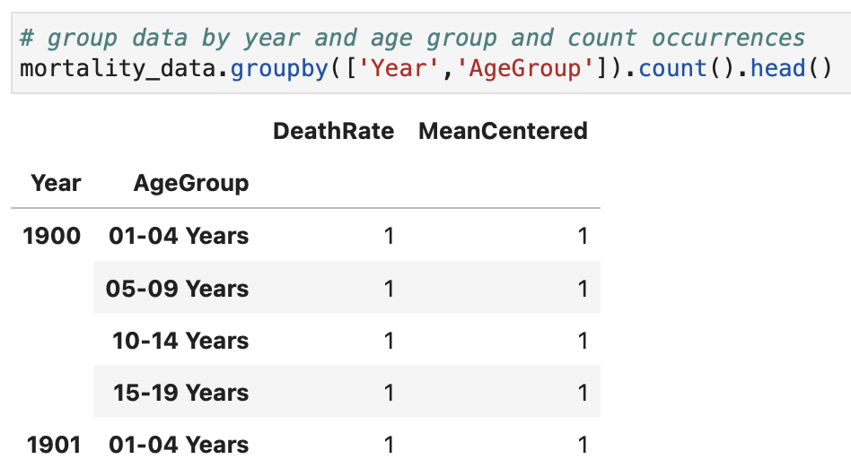
Group the Data(Cont.)

Slide 54
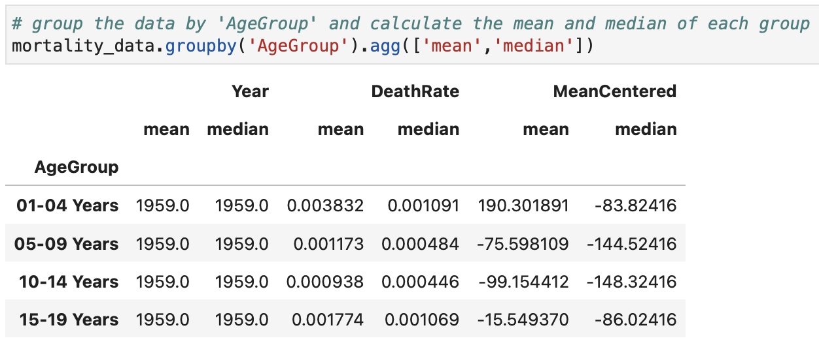
Aggregate the Data

Slide 55
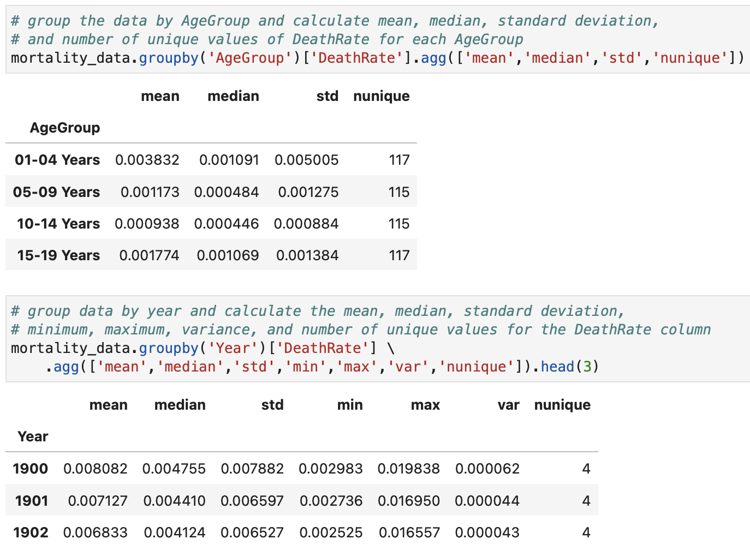
Aggregate the Data (Cont.)

Slide 56
Visualize the Data

Slide 57
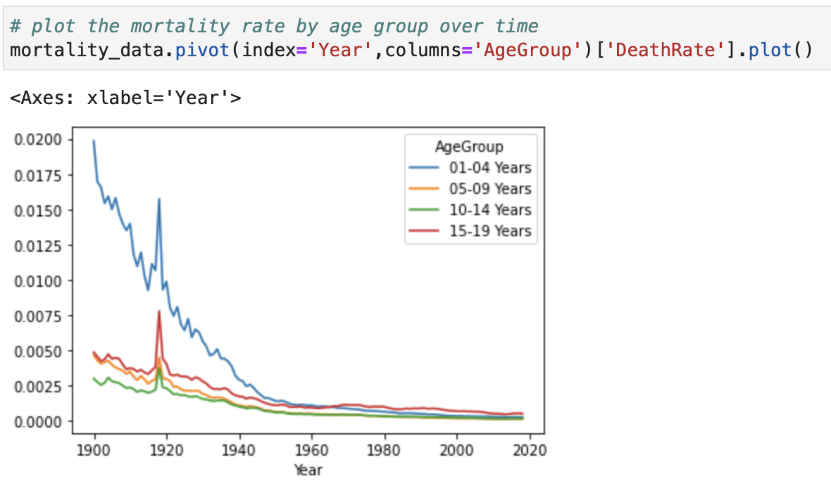
Visualise the Data: Line Plot

Slide 58
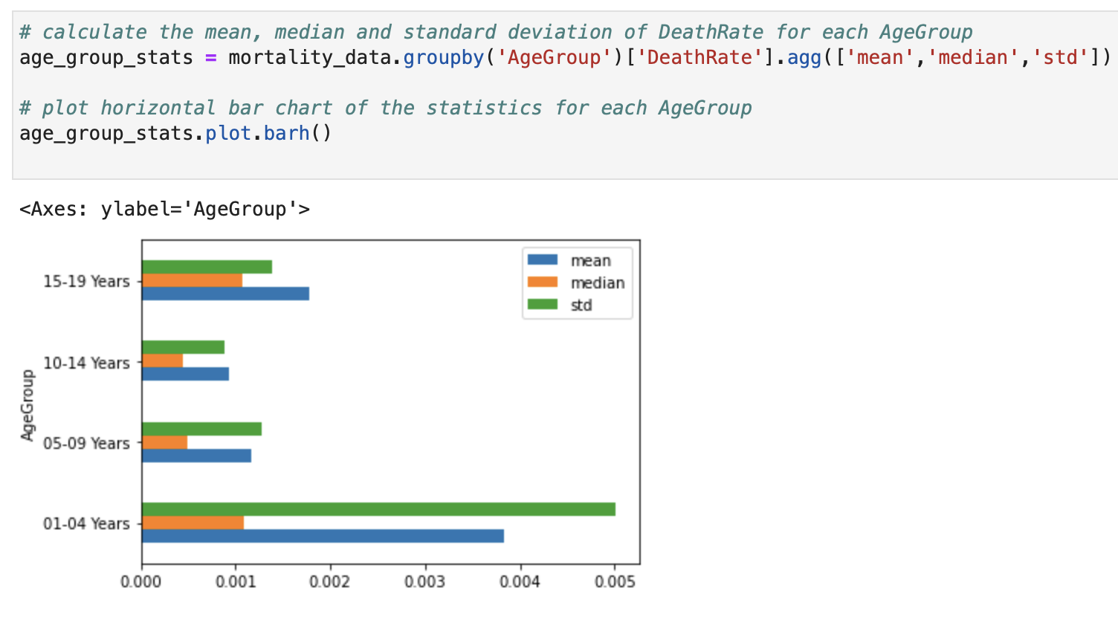
Visualize the Data: Bar Chart

Slide 59
References
Data science from scratch: first principles with Python, Joel Grus, O'Reilly Media, 2019
Python for Data Analysis: Data Wrangling with Pandas, NumPy, and IPython, Wes McKinney, O'Reilly Media, 3rd edition, 2022.
Python Data Science Handbook: Essential Tools for Working with Data, Jake Vanderplas, O'Reilly Media, 2022
Murach’s Python for Data Analysis, Scott McCoy, Mike Murach & Associates, Incorporated, 2021.
Intro to Python for Computer Science and Data Science: Learning to Program with AI, Big Data and The Cloud, Paul Deitel, Pearson Education Limited, 2021.
ChatGPT

Slide 60

End of lecture …

